Slide 1
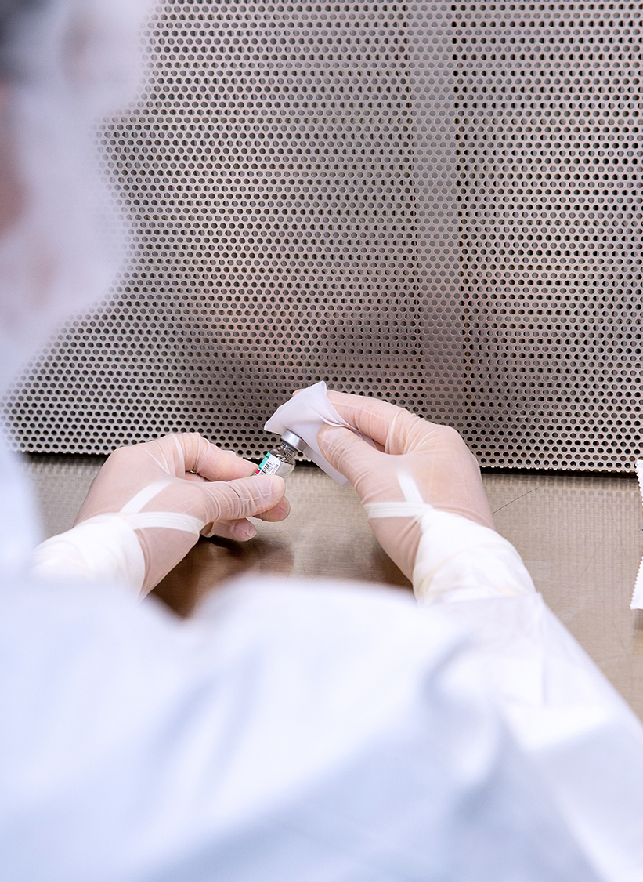
An Abundance of Drug and Staffing Shortages
Mark Hamm, PharmD, MBA, BCSCP
Aurora Health Care

Slide 2
Objectives
Review staffing turnover trends
Discuss strategies to reduce employee turnover
Review drug shortage trends
Discuss strategies used to navigate the carboplatin and cisplatin shortage

Slide 3
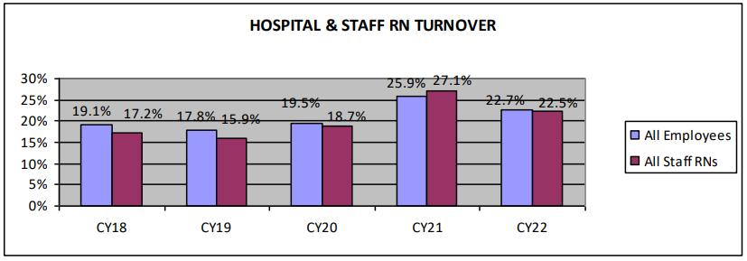
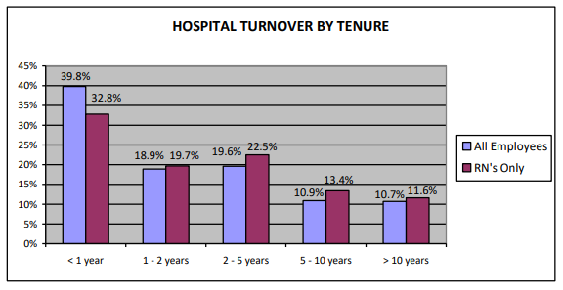
Hospital Employee Turnover By Year
Hospital turnover rate = 22.7% per year
Over 5 years, average hospital turnover is over 100% of workforce
Voluntary terminations accounted for 94.7% of all terminations
Over 50% of turnover occurs in the first two years of employment

Slide 4
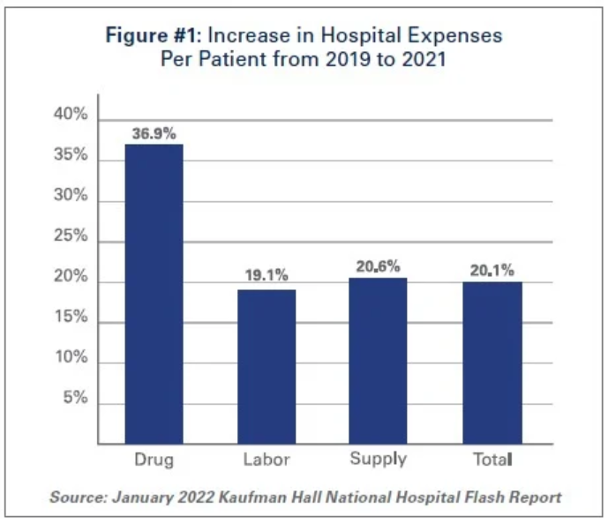
Impact of Labor Shortage on Hospital Budget
Hospital full time contract FTE grew 138.5% from 2019 to 2022
Hospital per patient labor costs grew ~20% during
Labor is approximately 50 percent of overall hospital/ health system budget
Throughout 2022, over half of hospitals operated at a financial loss

Slide 5
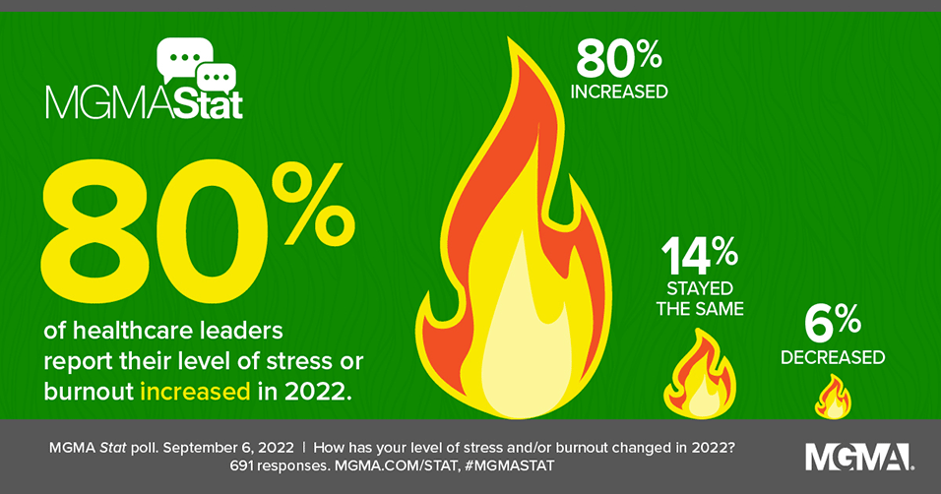
Leader Concerns
Time balance between activities to retain employees and time spent hiring new employees
33% of employees are open to internal opportunities
Average time to fill a position:
  Healthcare: 49 days
  All industry average: 36 days
2022 Deloitte well-being survey
  60% of employees, 64% of managers, and 75% of the C-suite are seriously considering quitting for a job that would better support their well-being

Slide 6
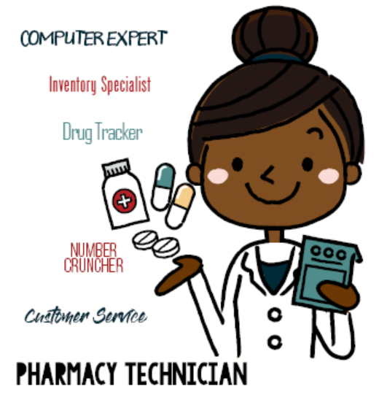
Pharmacy Technician Staffing
56% of pharmacy technicians view their job as long term careers
70% of pharmacies struggling to fill staff positions according to NCPA survey
ASHP survey indicates 74% of respondents have shortage of technicians for frontline roles
83 % of pharmacy technicians surveyed said they are taking on more work than pre-pandemic
Turnover rate:
  2022: 26.9%
  2014: 13.2%
Employment projection: 5% growth in next 10 years

Slide 7
ASHP Pharmacy Advancement Initiatives for Pharmacy Technicians
Practice-focused:
D1. Pharmacy technicians should participate in advanced roles in all practice settings to promote efficiency and improve access to patient care.
D2. Pharmacy technicians should have complete responsibility for advanced technical and supporting activities (e.g., order fulfillment, tech-check-tech, regulatory compliance, supply chain management, diversion prevention, revenue cycle management, patient assistance programs).
Organization-focused:
D3. All newly hired technicians should have completed an ASHP/ACPE-accredited technician education and training program.
D4. Health systems should require technicians to be certified by the Pharmacy Technician Certification Board.
D5. Pharmacy departments should foster the development of professional career paths for pharmacy technicians.
Profession-focused:
D6. A scope of practice including core competencies should be developed and defined for pharmacy technicians in acute-care and ambulatory-care settings.

Slide 8
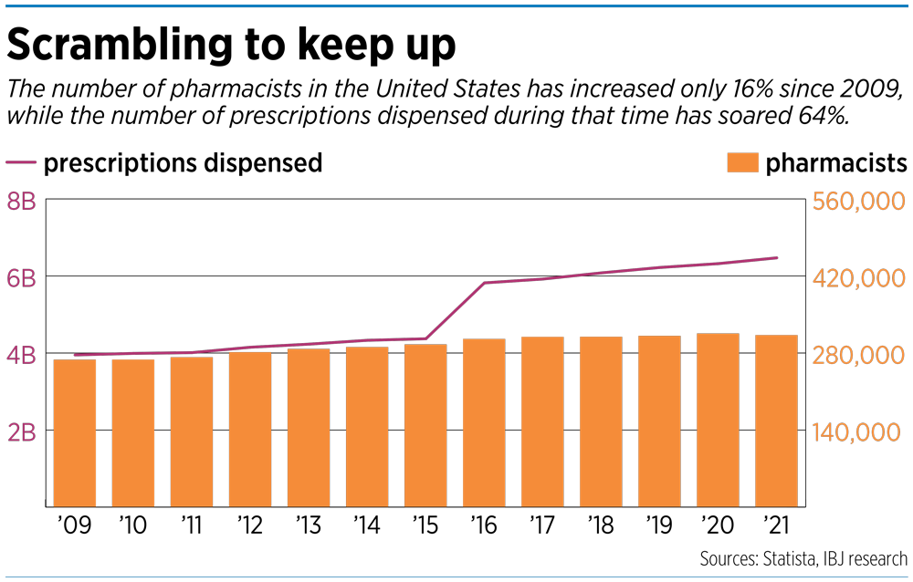
Pharmacist Staffing Points of Consideration
Pharmacy school applications:
2011: 106,815
2015: 76,525
2021: 40,552
~13,400 openings for pharmacists are projected each year over next 10 years.
Annual pharmacist turnover
2022: 11%
2014: 6.8%

Slide 9
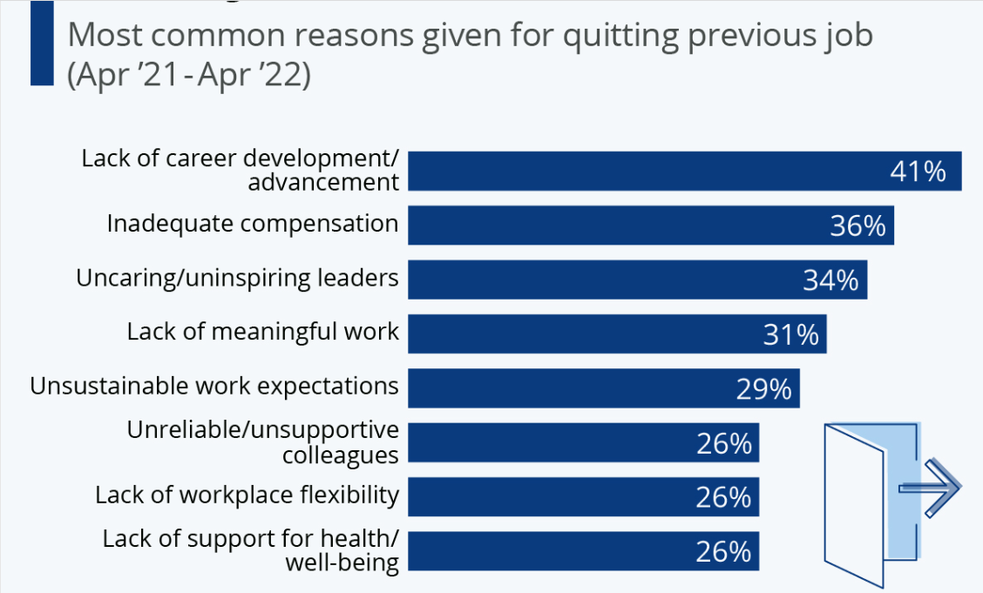
What Factors Matter Most to Employees?
Benefits
Provide competitive compensation and benefits
Pay above average salaries
Work Environment
Offer career development and growth opportunities
Incentivize loyalty
Prioritize culture and connection
Show appreciation and respect
Encourage input and feedback
Identify and invest in high performers
Allow employees to speak their minds
Relationship with their supervisor
Life Needs
Provide flexibility
Invest in taking care of your employees and their families
Provide work life balance
https://www.uschamber.com/co/run/human-resources/how-to-retain-top-employees. Accessed September 23, 2023
https://www.linkedin.com/pulse/5-effective-strategies-retain-employees-your-organization-harish-s. Accessed September 23, 2023
https://hbr.org/2021/11/6-strategies-to-boost-retention-through-the-great-resignation. Accessed September 23, 2023
https://www.zippia.com/advice/survey-why-workers-quit-job/ Accessed September 16, 2023

Slide 10

What Drives Employees to Care?
Autonomy
A desire to be self directed
Mastery
the urge to get better skilled
Purpose
the desire to do something that has meaning and is important.

Slide 11


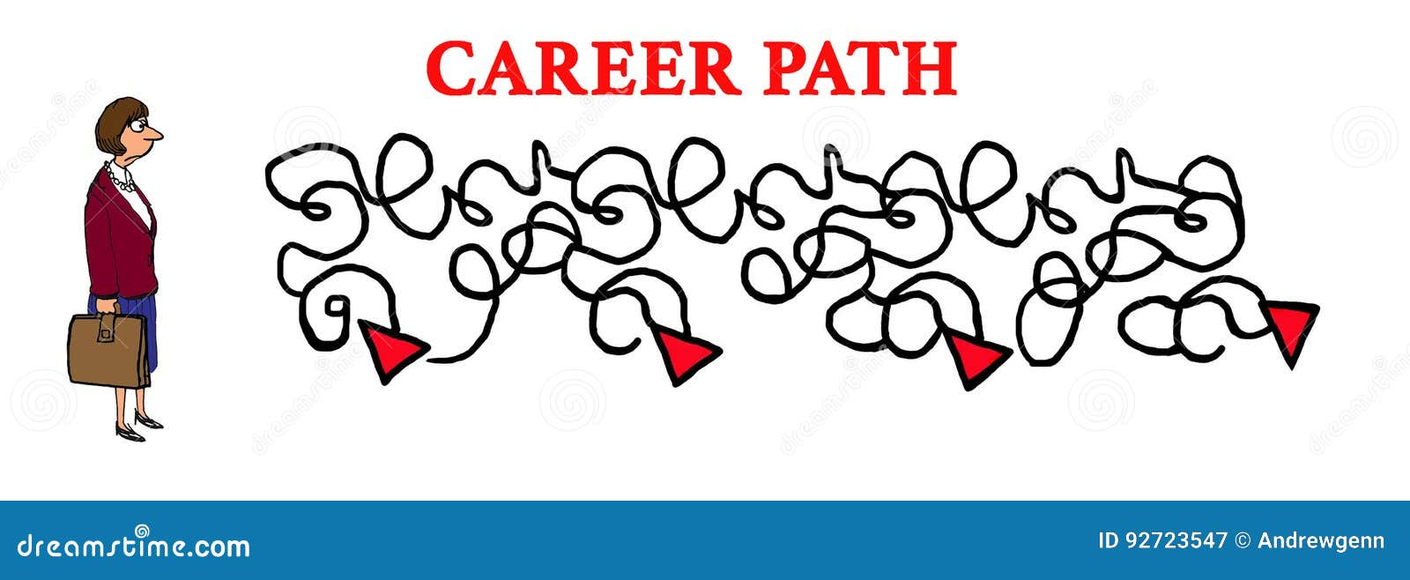
Strategies to Increase Engagement
Shared decision making/ governance

Slide 12
Drug Shortage Overview
In Q2 2023, 309 active drug shortages were reported
A 2023 drug shortage survey indicated
99% of respondents reported experience with a drug shortage
32% were experiencing a shortage that required rationing, delaying or canceling treatment
63% were moderately impacted
Estimated drug shortages add 5-20% to annual drug budget
359M in labor costs to manage drug shortages
8.6M hours of additional labor

Slide 13
Drug Shortage Causes
Manufacturing/ regulatory problems
No manufacturer quality system
Complex supply chains
Natural disasters
Lack of manufacturer transparency
Raw material unavailable
Low profitability
https://www.uspharmacist.com/article/factors-involved-in-us-generic-drug-shortages. Accessed September 20, 2023
https://www.bloomberg.com/news/newsletters/2023-10-12/why-are-generic-drugs-hard-to-find-because-they-re-not-profitable. Accessed October 12, 2023
https://qualitymatters.usp.org/geographic-concentration-pharmaceutical-manufacturing#:~:text=The%20FDA%20analysis%20showed%20that,with%2013%20percent%20in%20China.. Accessed September 2023

Slide 14
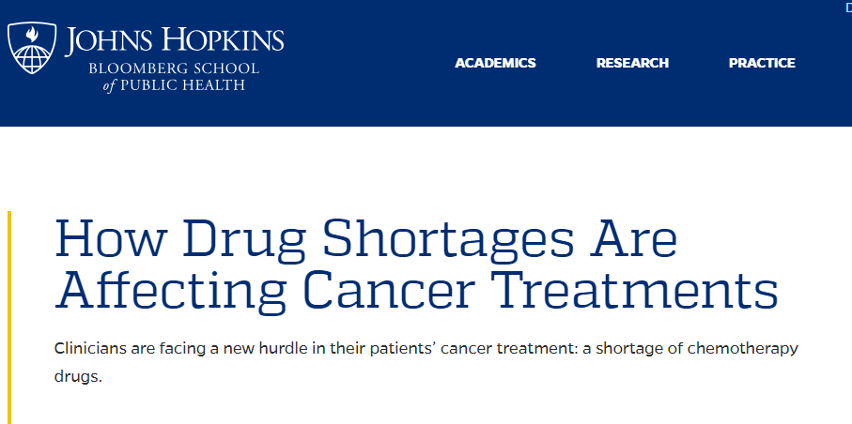

Slide 15
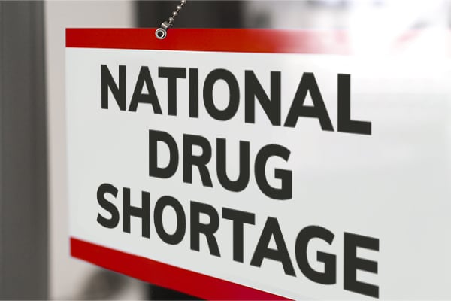
Key Events for Carboplatin and Cisplatin Shortage
Cisplatin and carboplatin are mainstays of therapy for many different types of cancer
Beginning in early 2023, availability of both cisplatin and carboplatin decreased
5 or fewer manufacturers of each drug with one manufacturer (Accord Health) owning approximately 50 percent market share
By April 2023 our health system had less than one month supply of drug to treat active patients and no drug supply on the market
A consistent supply of drug was not available until mid to late June 2023 and cancer centers are continuing with this issue today
Notes:
https://www.google.com/search?q=carboplatin+cisplatin+shortage&tbm=isch&ved=2ahUKEwji5ufiteeBAxVcNd4AHWRLDTMQ2-cCegQIABAA&oq=carboplatin+cisplatin+shortage&gs_lcp=CgNpbWcQAzIHCAAQGBCABDoECCMQJzoGCAAQCBAeOgQIABAeUJwHWM8NYL8OaABwAHgAgAFpiAG8BpIBAzkuMZgBAKABAaoBC2d3cy13aXotaW1nwAEB&sclient=img&ei=ciIjZeLlB9zq-LYP5Ja1mAM&bih=942&biw=1920#imgrc=Jg7FavIyWIpI3M

Slide 16

Immediate Strategies to Manage the Shortage
Sourcing
Direct orders
Secondary wholesalers
No gray market wholesalers
Evaluate clinical alternatives for patients
Centralized management of all remaining carboplatin and cisplatin
Extensive drug sharing throughout the health system
Establish multidisciplinary drug shortage management team

Slide 17
Drug Shortage Management Team
Medical oncologists
Drug Shortage Response Team
Patient Safety
Clinical Risk Management
Ethics
Nursing
Pharmacy
Spiritual Care
Public Affairs
Emergency Preparedness

Slide 18
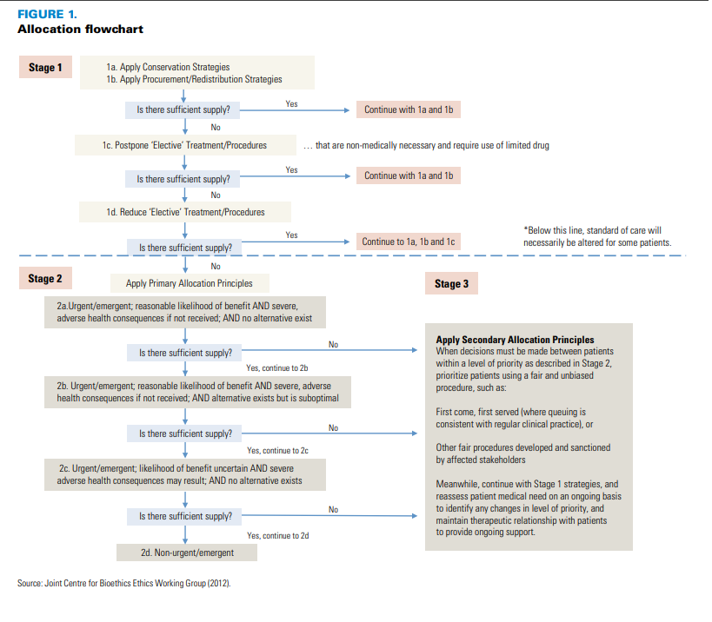
Stage 1 examples
Sharing drug supply throughout system
Exploring additional wholesaler options
Change drug(s) to new drug(s) with comparable evidence
Stage 2 examples
Curative vs non-curative intent
Available alternative options?
Stage 3 examples
Individual patient scoring system
Greatest likelihood of positive outcome
Lottery/ random assignment

Slide 19
Last Thoughts
One manufacturer exiting the market impacted a very large number patients
Additional need to increase on hand supply of generic injectable chemotherapy drugs
Generic injectable drug market will continue to struggle with demand if manufacturers exit the market
There was a need to expand participants on our drug shortage team
Drug Shortage Prevention Act of 2023 was introduced in Congress, we must be aware of these efforts and support them
We must continue telling the drug shortage story to advocate for patients and for health systems!

